Slide 1
Secure Messaging Platform for Health in Singapore

Slide 2
Thank You !

Slide 3
Agenda
IBM & Tetherfi
Omni-App Features
Sample Use case with flow and rules
Interaction Workflow Designer & IBM Watson
Message Broadcasting
Integration with Other Messaging Channels
Q & A : Discussion
Next Steps

Slide 4
IBM & tetherfi

Slide 5
tetherfi Customers
In SINGAPORE
REGIONAL
Singapore Govt Agencies not shown

Slide 6
Agenda
IBM & tetherfi
Omni-App Features
Sample Use case with flow and rules
Interaction Workflow Designer & IBM Watson
Message Broadcasting
Integration with Other Messaging Channels
Q & A : Discussion
Next Steps

Slide 7
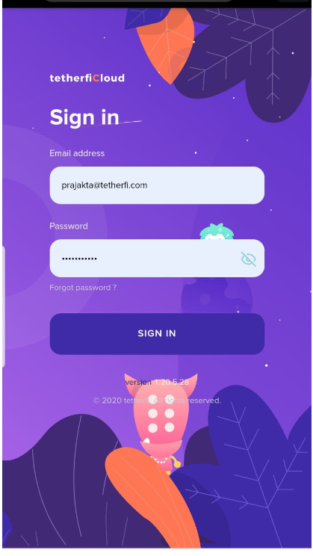
Omni-App Features
Omni App - Workspace
Messaging
Text, images
Audio/video
File sharing
Screen share
Audio/Video call
Group Messaging
Support AD authentication,2FA,Email

Slide 8
Omni App- Workspace
Workspace creation
Group creation
Unread message count
Typing status

Slide 9
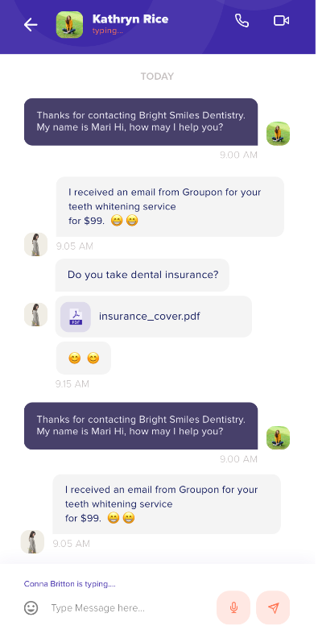
Omni App- Text, Images
One-One messaging , sending Emoji
Audio/video share with group/ individual
Seen, read, delivered receipt

Slide 10
Omni App –Audio/Video
Audio/video share with group/ individual

Slide 11
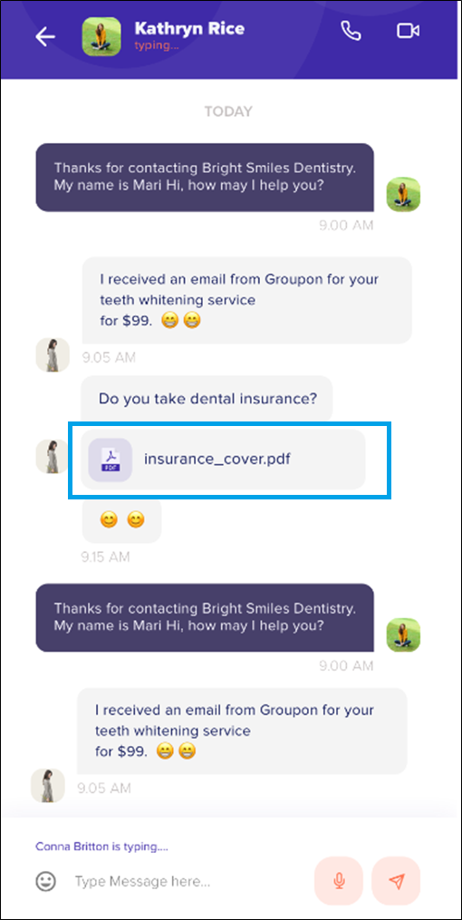
Omni App- File Share
File Share with the contact

Slide 12
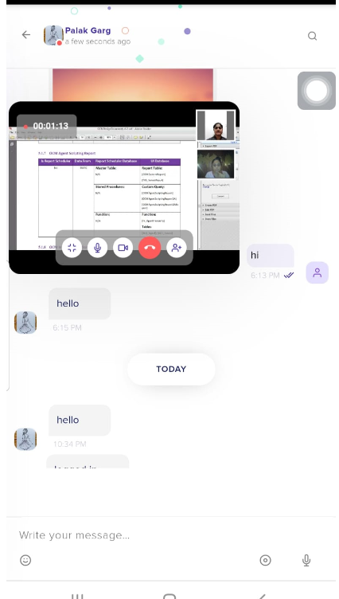
Omni App –Screen Share
Screenshare with contact

Slide 13
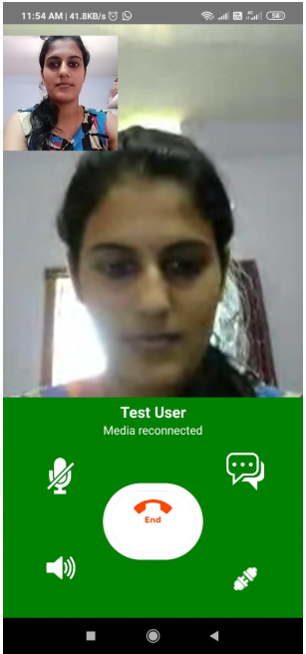
Omni App- Audio/Video Call
Video call with the contact

Slide 14
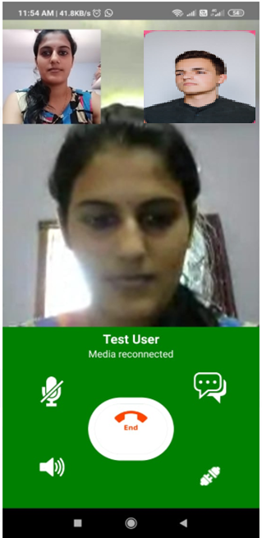
Omni App- Conference
Video call conference

Slide 15
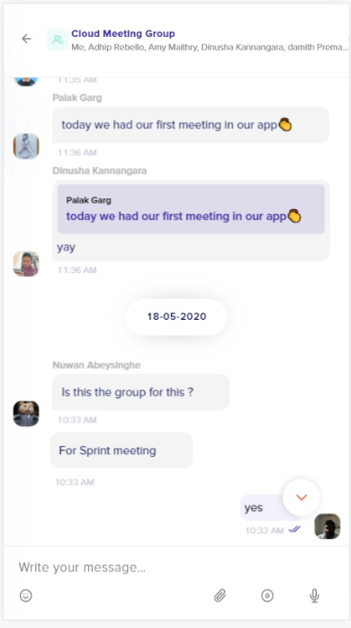
Omni App- Group Message
Create a group and messaging

Slide 16
Agenda
IBM & Tetherfi
Omni-App Features
Sample Use case with flow and rules
Interaction Workflow Designer & IBM Watson
Message Broadcasting
Integration with Other Messaging Channels
Q & A : Discussion
Next Steps

Slide 17
Sample use case with flow and rules
Do diabetes
Do Blood test
Meet the Lab technician for further reports
1. Patient Walks into Hospital
2. Meets relevant doctor
3. Doctor prescribes next steps
4. Patient Meets Lab Technician for prescribed test / scans
5. Lab Technician done the test and update to the LIS
9. Notifies patient via preferred channel
8. Notifies Technician via Omi APP
7. Notifies Doctor via Omi APP
Work flow will send notification to the Available Doctor
6. Work Flow Engine (IW)
IW will pull the report from LIS and notify the specialist
LIS System

Slide 18
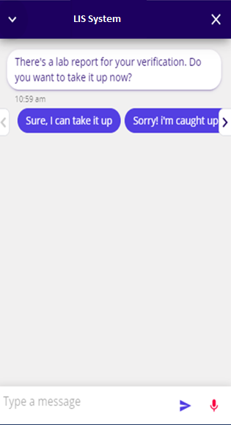
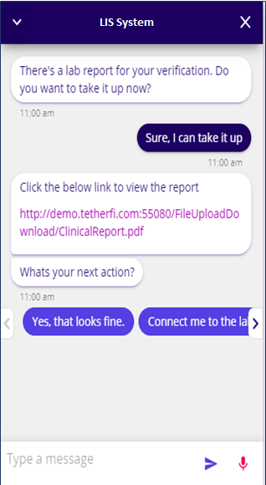
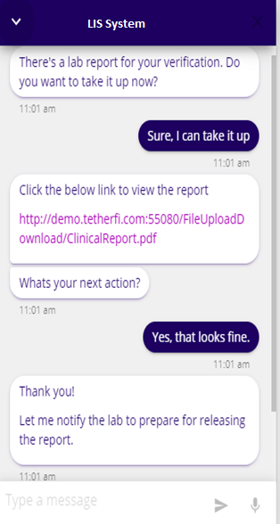
Use Case 1: Doctor Approves Report
LIS System
LIS System
Work Flow Engine (IW)
Work Flow Engine (IW)
Work flow engine will update the LIS with approved status and Also will notify the Patient and Lab Asst.
Rooster Database System Work flow will fetch Doctor’s Rooster Information
Shift Doctor receives the report as notification and clicks the notification to proceed
Doctor views the report to decide on the next action
Doctor approves the report

Slide 19
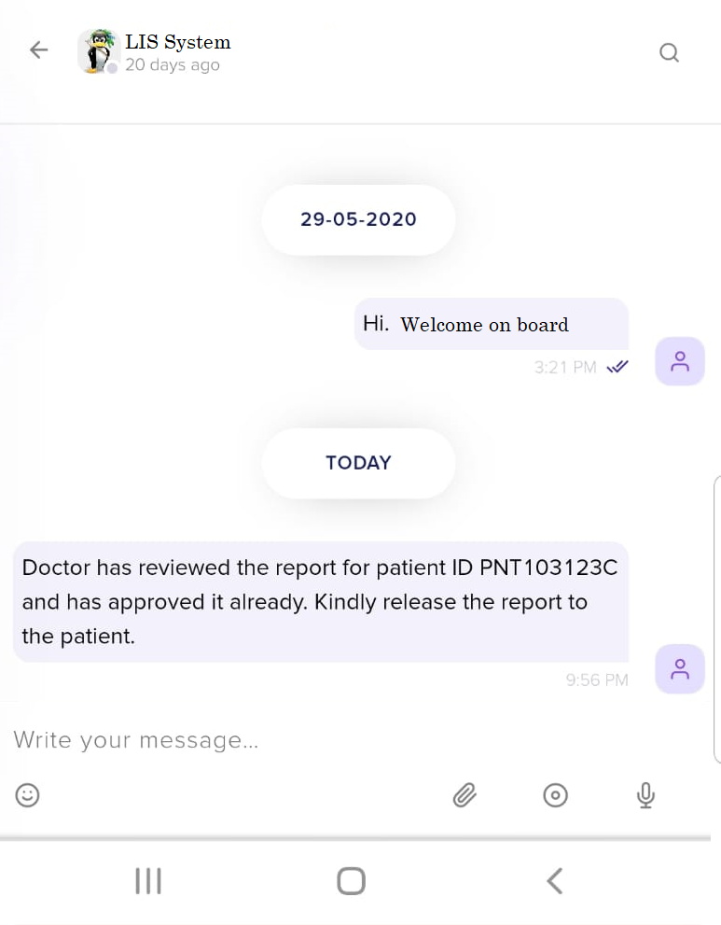
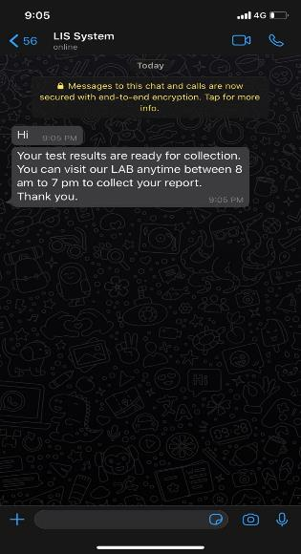
Use Case 1: Doctor Approves Report contd
LIS System
Work Flow Engine (IW)
Rooster Database System Work flow will fetch Doctor’s Rooster Information
Lab Asst. receives notification in his Omni APP
Patient receives notification in his preferred channel

Slide 20
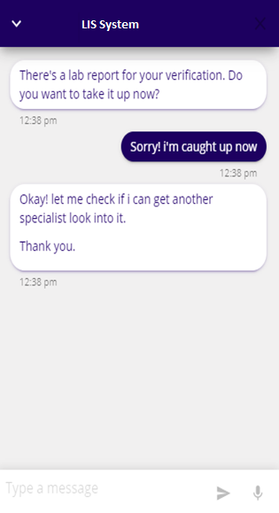
Use Case 2: Doctor couldn’t look into the report
LIS System
Work Flow Engine (IW)
Work Flow Engine will look into the Rooster to identify the next available Doctor
Work Flow Engine (IW)
Work flow Engine will send notification to the next Available doctor
Rooster Database System Work flow will fetch Doctor’s Rooster Information
Doctor receives the work flow as notification, but couldn’t work on it now
Hospital Database System Work flow will fetch Doctor’s Rooster Information

Slide 21
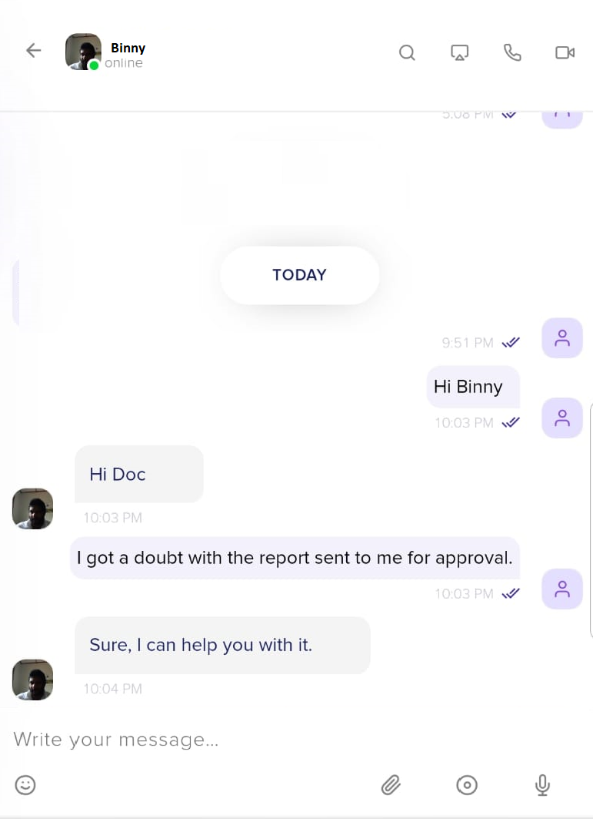
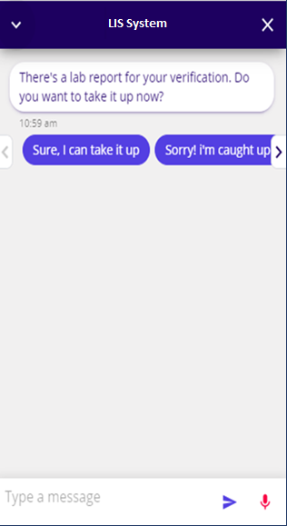
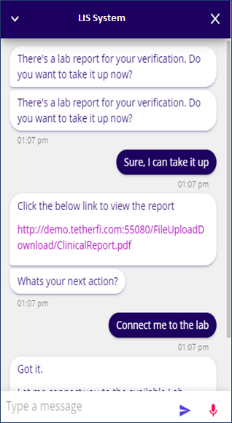
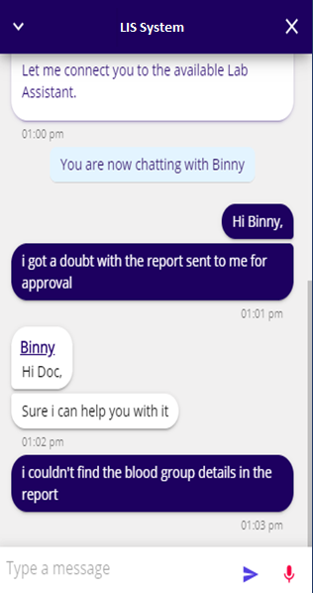
Use Case 3: Doctor prefers chatting with Lab Asst
LIS System
Work Flow Engine (IW)
Work Flow Engine (IW) identifies the available Lab Asst and connects with the Doctor
Lab Technician receives messages from Doctor in Omni APP
Doctor receives the report as notification and clicks with notification to proceed
Doctor prefers to chat with the Lab Asst to clarify his queries
Doctor chats with the Lab Asst directly
Rooster Database System Work flow will fetch Doctor’s Rooster Information

Slide 22
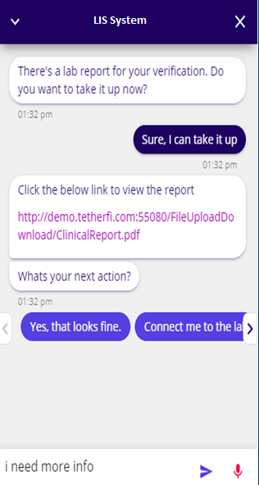
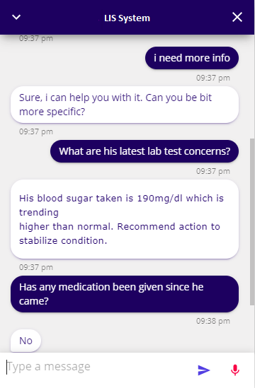
Use Case 4: Doctor wants to query patient info
LIS System
Work Flow Engine (IW)
Work Flow Engine (IW)
invokes IBM Watson BOT to identify the response for his queries
Rooster Database System Work flow will fetch Doctor’s Rooster Information
Doctor directly chats with the system to clarify his queries
Based on the response from Watson, Work flow engine will fetch information and provide it to Doctor

Slide 23
Sample use case with flow and rules
Do diabetes
Do Blood test
Meet the Lab technician for further reports
1. Patient Walks into Hospital
2. Meets relevant doctor
3. Doctor prescribes next steps
4. Patient Meets Lab Technician for prescribed test / scans
5. Lab Technician done the test and update to the LIS
9. Notifies patient via preferred channel
8. Notifies Technician via Omi APP
7. Notifies Doctor via Omi APP
Work flow will send notification to the Available Doctor
6. Work Flow Engine (IW)
IW will pull the report from LIS and notify the specialist
LIS System

Slide 24
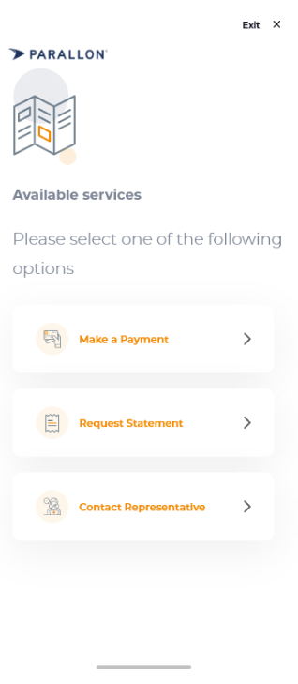
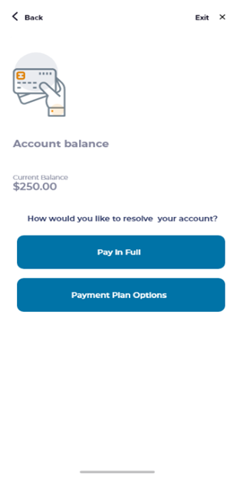
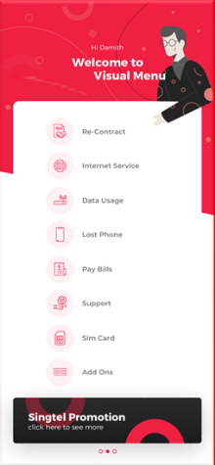
Different Flavors of the Workflow UI

Slide 25
Agenda
IBM & Tetherfi
Omni-App Features
Sample Use case with flow and rules
Interaction Workflow Designer & IBM Watson
Message Broadcasting
Integration with Other Messaging Channels
Q & A : Discussion
Next Steps

Slide 26
Overall Design with Workflow and Broadcast Messaging
5
Response Handling Service (API): Out of Box
All the data approved/submitted by the doctor is pushed to the enterprise system using the respective API
4
Configurable Workflow: Out of Box
Workflow can process the data and invoke respective systems to send notification
1
API Integration: Out of Box
Any Enterprise system can directly invoke the Workflow API with data
Workflow#1:Doctor
4a
Trigger Notification Workflow
Omni App Notification API
OMNI App
4b
2
Listener Service: Road Map
Listener service will integrate with different other enterprise systems
Workflow#2:LabAsst
6
Broadcast Messaging Service: Out of Box
Based on workflow logic, broadcast notification service is triggered
8
Status and Results Log and Exception Reporting: Out of Box
All notifications and process logs are maintained and reports etc.
Polling Service
Broadcast Notification Service
SMS Gateway Manager
Enterprise
System
Listener
Message Queue
3
Configurable Invoker: Road Map
Listener service will invoke Workflow service with inputs required.
More data set can be handled that can be leveraged to set more rules in Workflow for further processing without changing interface.
7
Scheduled Notification: Out of Box
Notification service can schedule or send immediate notification to the contacts
Enterprise
Systems
File System
9
Response Handling Service : Out of Box
All the data approved/submitted by the patients is pushed to the enterprise system databases

Slide 27
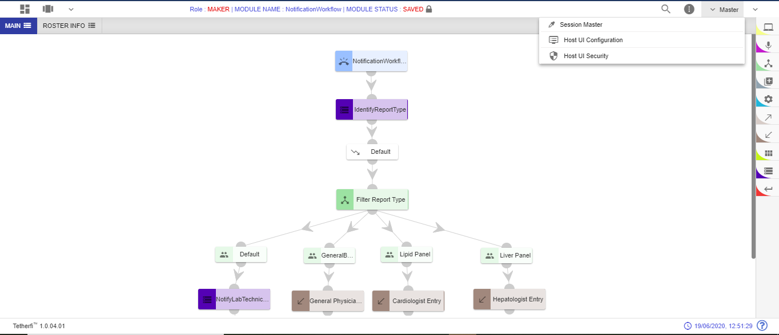
Notification Workflow
Notification Workflow API will receive set of data(like system name, message type, etc) needed for processing from the system that triggers it
Instant API configuration page
Tabs to manage work flow functions
Host Node to invoke any API and Interfaces
Various palette items needed for designing workflow
Condition Node to filter and validate any conditions
Connectors to connect to functions in different tab

Slide 28
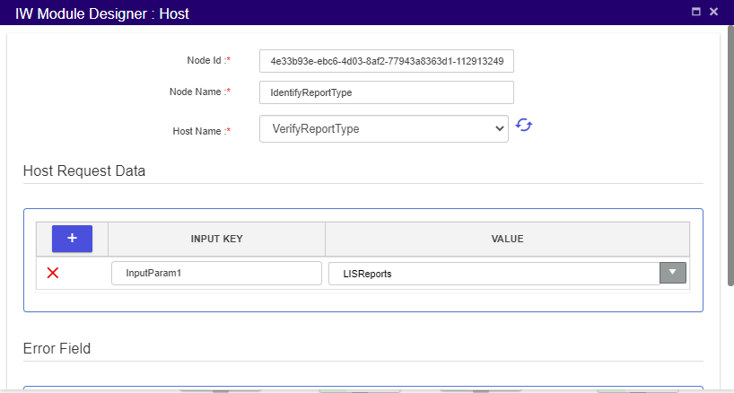
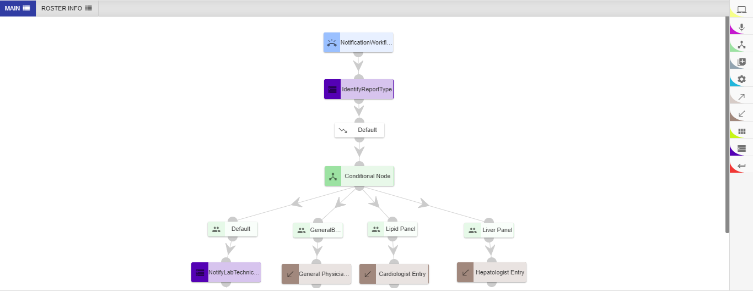
Notification Workflow
select the preconfigured API

Slide 29
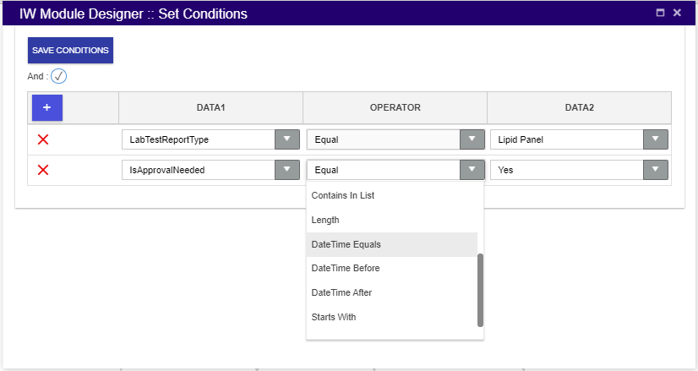
Notification Workflow
Tabs to manage work flow functions
Host Node to invoke any API and Interfaces
Add conditions to filter out report types
Various other conditional operators

Slide 30
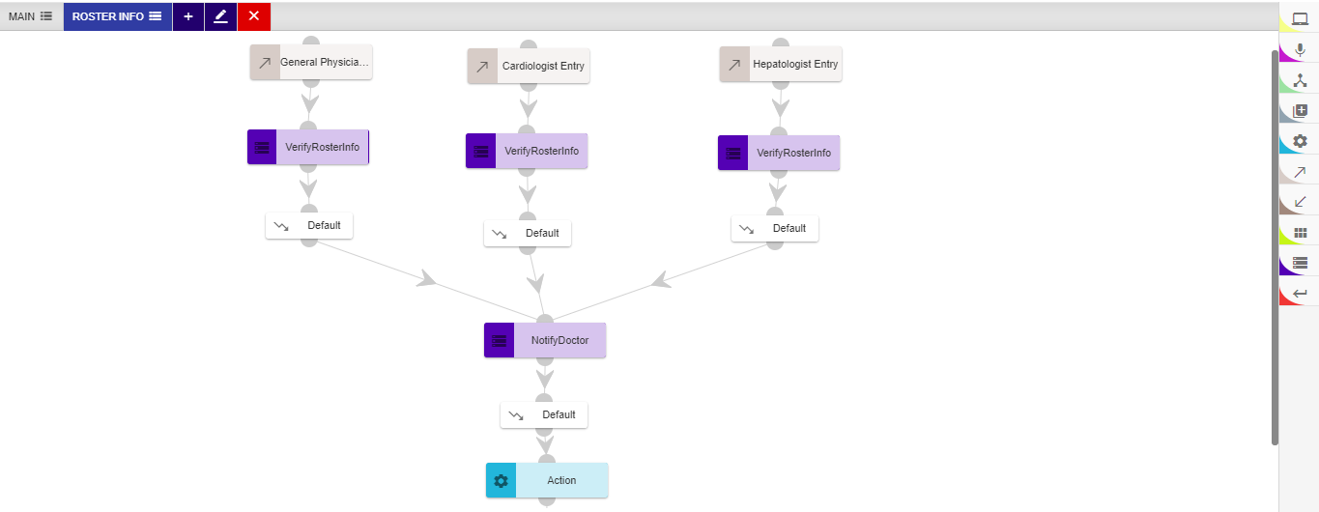
Notification Workflow
Host Node Identify Roster Info of General Physician using Roster API
Host Node to notify the identified doctor in OMNI-APP
Action Node to perform all logical operation and custom coding if needed

Slide 31
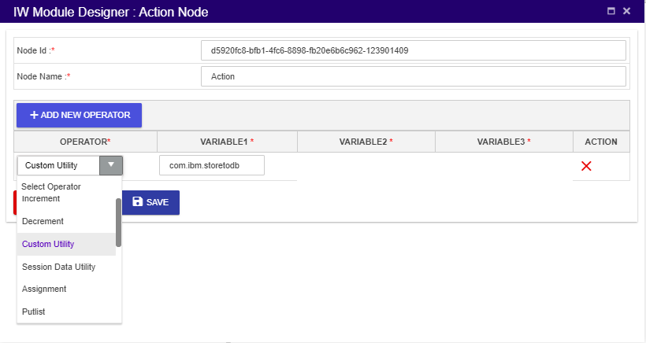
Notification Workflow
Custom JAVA code’s package reference that needs to be executed.
List of various logical operations needed for the workflow

Slide 32
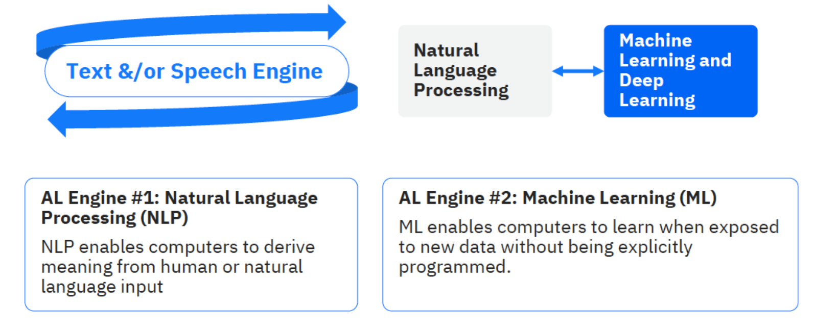
IBM Watson Chatbot

Slide 33
Agenda
IBM & Tetherfi
Omni-App Features
Sample Use case with flow and rules
Interaction Workflow Designer & IBM Watson
Message Broadcasting
Integration with Other Messaging Channels
Q & A : Discussion
Next Steps

Slide 34
Overall Design with Workflow and Broadcast Messaging
5
Response Handling Service (API): Out of Box
All the data approved/submitted by the doctor is pushed to the enterprise system using the respective API
4
Configurable Workflow: Out of Box
Workflow can process the data and invoke respective systems to send notification
1
API Integration: Out of Box
Any Enterprise system can directly invoke the Workflow API with data
Workflow#1:Doctor
4a
Trigger Notification Workflow
Omni App Notification API
OMNI App
4b
2
Listener Service: Road Map
Listener service will integrate with different other enterprise systems
Workflow#2:LabAsst
6
Broadcast Messaging Service: Out of Box
Based on workflow logic, broadcast notification service is triggered
8
Status and Results Log and Exception Reporting: Out of Box
All notifications and process logs are maintained and reports etc.
Polling Service
Broadcast Notification Service
SMS Gateway Manager
Enterprise
System
Listener
Message Queue
3
Configurable Invoker: Road Map
Listener service will invoke Workflow service with inputs required.
More data set can be handled that can be leveraged to set more rules in Workflow for further processing without changing interface.
7
Scheduled Notification: Out of Box
Notification service can schedule or send immediate notification to the contacts
Enterprise
Systems
9
Response Handling Service : Out of Box
All the data approved/submitted by the patients is pushed to the enterprise system databases
File System

Slide 35
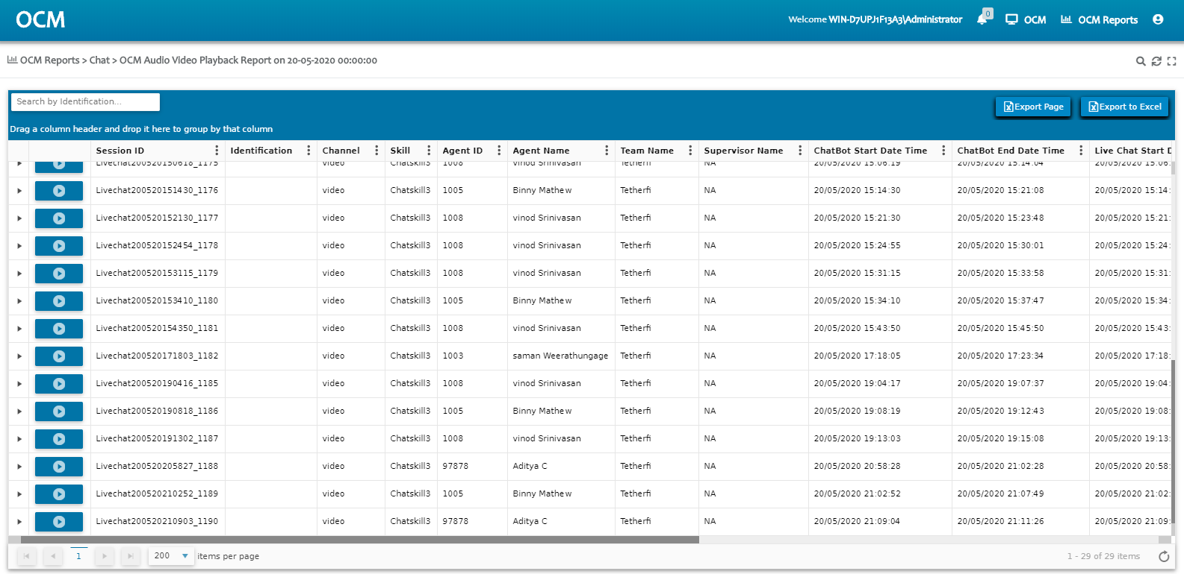
Message Broadcasting : T-Notifier
T- Notifier
Batch
Broadcast Messages
Logs/Reports
Integrate t-Notifier system can integrate via API and batch to broadcast message to users via omni-channels
Rules can be configured for automatic exception handline for alternate/multiple channel
For Omni-App, the speed is only constrained by resources.
For Social Media apps (Line) is appx 10K messages in 1 min.
For a basic SMS Gateway it is appx 10K messages in 10 mins.
Web based Reporting for status of batch results/exceptions

Slide 36
Agenda
IBM & Tetherfi
Omni-App Features
Sample Use case with flow and rules
Interaction Workflow Designer & IBM Watson
Message Broadcasting
Integration with Other Messaging Channels
Q & A : Discussion
Next Steps

Slide 37
Integration with Other messaging channels
Tetherfi Social media connector
Line
WhatsApp
Facebook Messenger
Telegram
Viber
We-chat
Telephony Connector
Voice Gateway
FAX Gateway
Enterprise App Connector
SMS Gateway
Email Gateway
Custom App Connector
Web App
ChatBot

Slide 38
Agenda
IBM & Tetherfi
Omni-App Features
Sample Use case with flow and rules
Interaction Workflow Designer & IBM Watson
Message Broadcasting
Integration with Other Messaging Channels
Q & A : Discussion
Next Steps

Slide 39
Discussion

Slide 40
Agenda
IBM & Tetherfi
Omni-App Features
Sample Use case with flow and rules
Interaction Workflow Designer & IBM Watson
Message Broadcasting
Integration with Other Messaging Channels
Q & A : Discussion
Next Steps

Slide 41
Next Steps
Detailed Technical Architecture
Live Demonstration

